Slide 1

www.atrico.org
@hargreavesbc
Carmel Schools
Netherlands
“Moving” Beyond The Pandemic:
Equity, Prosperity, Enhanced Technology & Collective Responsibility
Andy Hargreaves

Slide 2
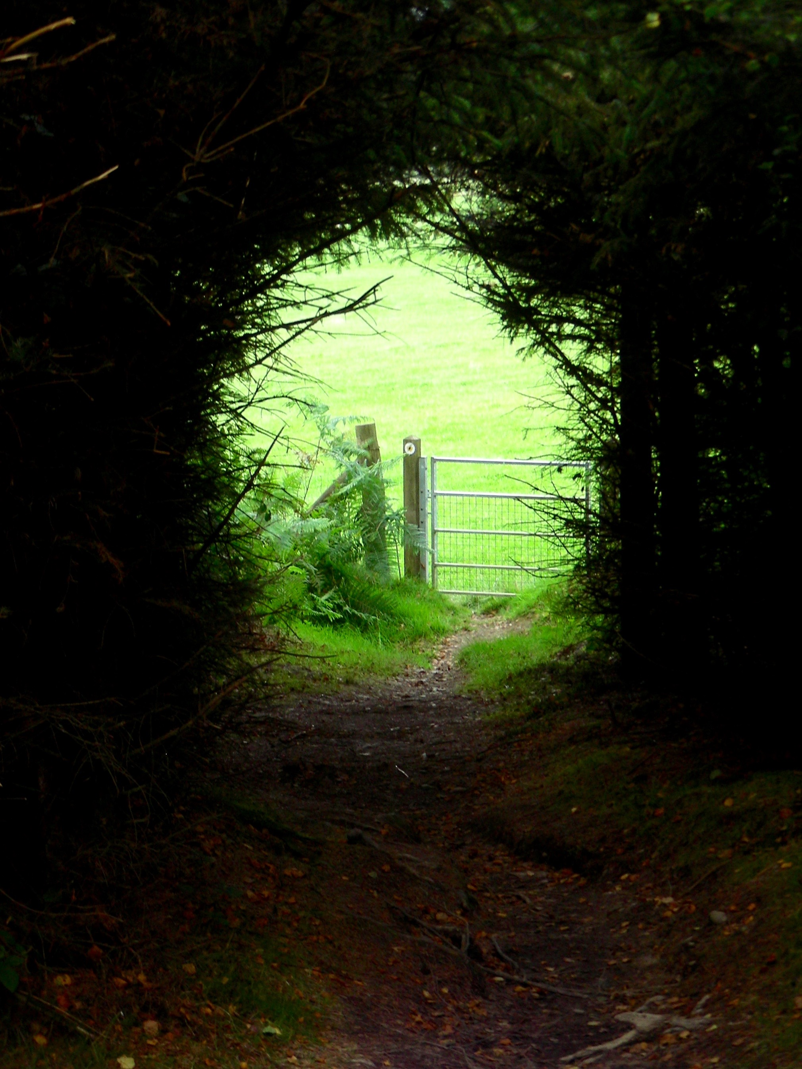
There is light at the end of this tunnel.

Slide 3
But which way will we go then?

Slide 4
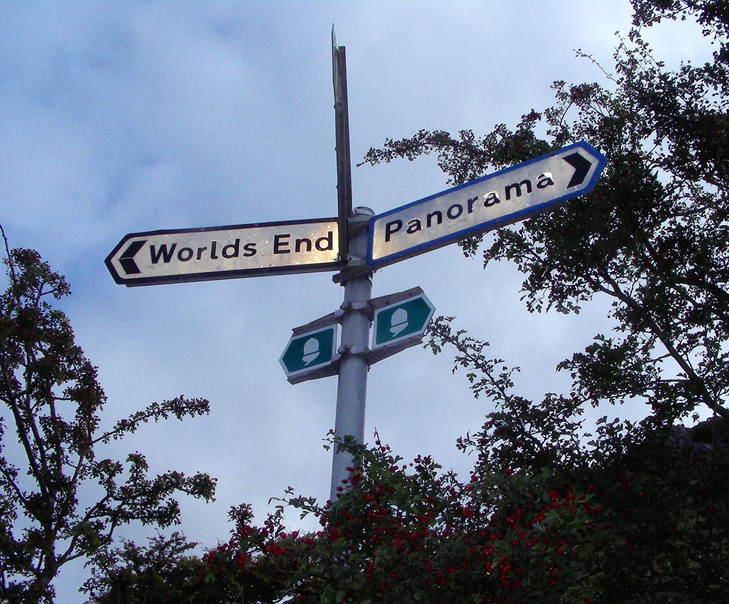
Pandemonium
or
Panorama

Slide 5
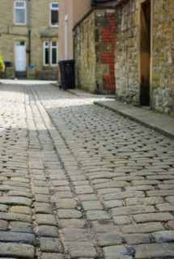

Equity &
Social Mobility

Slide 6
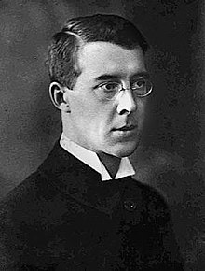
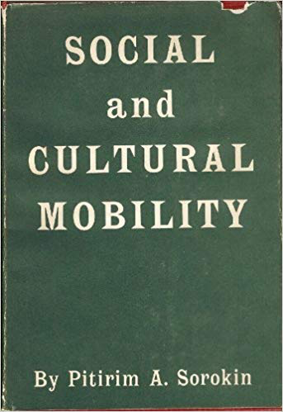

Slide 7
Social mobility is not an alternative to greater equity.
It’s the consequence of greater equity.

Slide 8
Pandemonium | Panorama
Austerity | Prosperity
Blended Technology | Enhancing Technology
Top-Down Accountability | Collective Responsibility

Slide 9
Austerity

Slide 10
Austerity & Growth : two sides of the same debased coin

Slide 11


Slide 12


Slide 13


Slide 15

The old meritocracy becomes the new aristocracy
Tax extreme wealth

Slide 16


Wealth is protected by
Financial deregulation
Tax avoidance
Savings not being invested
Political Lobbying
Tax-subsidized charities
Legacy donations
Changing the subject
.

Slide 17
Prosperity

Slide 18
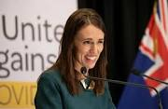
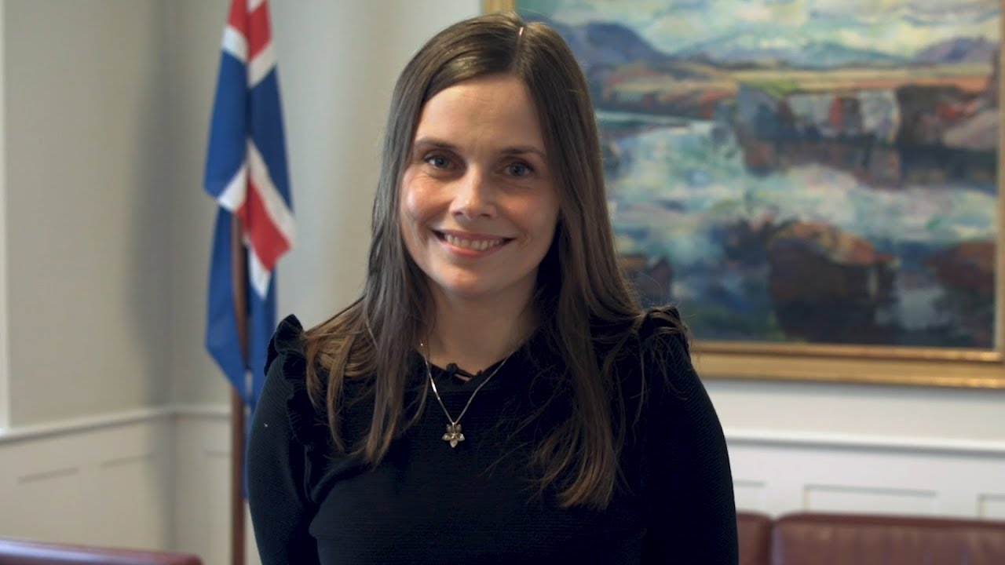
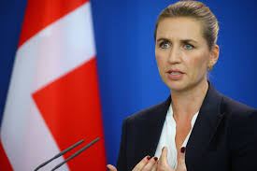
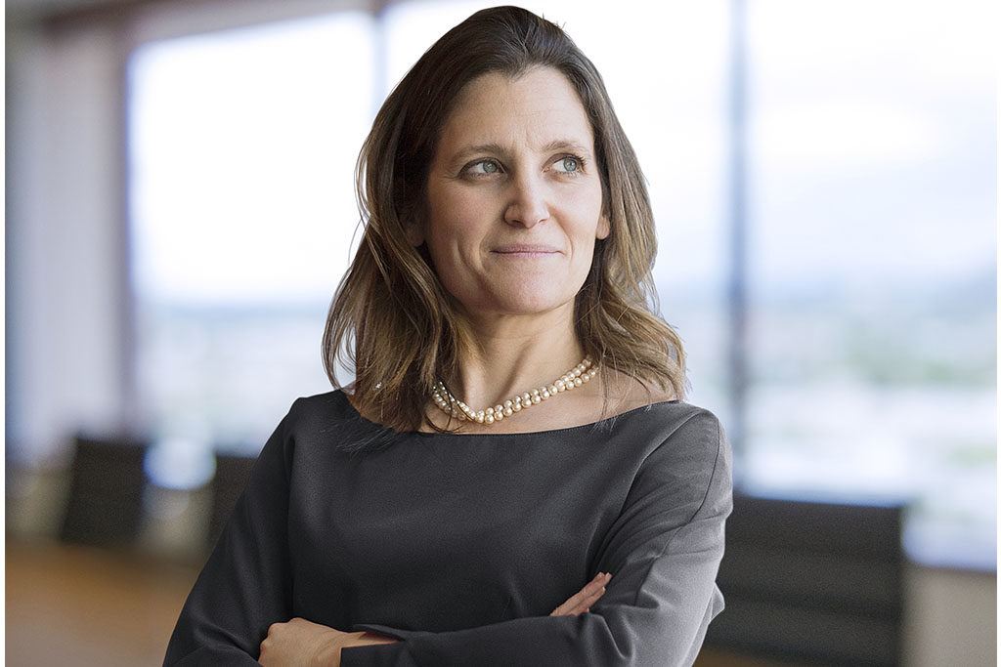
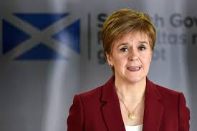
Quality of Life
not just
GDP

Slide 19
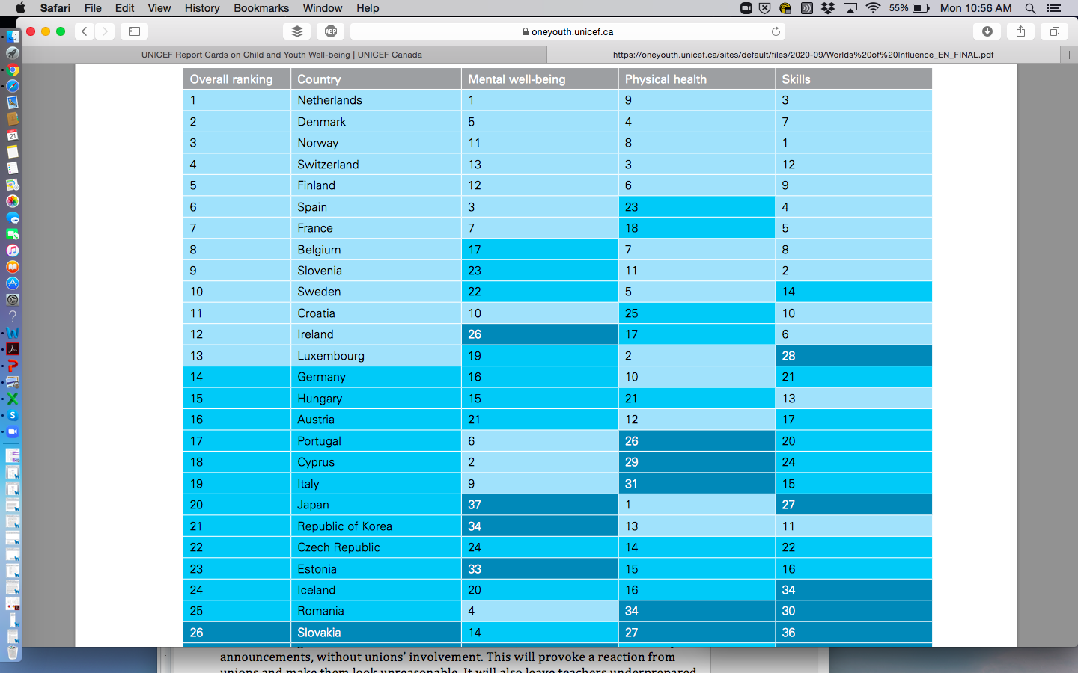

Slide 20
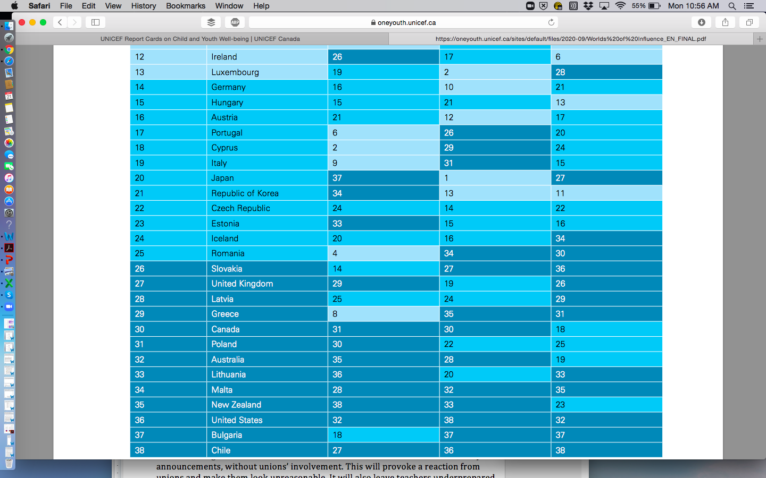

Slide 21
Austerity
Blended & Hybrid Technology

Slide 22
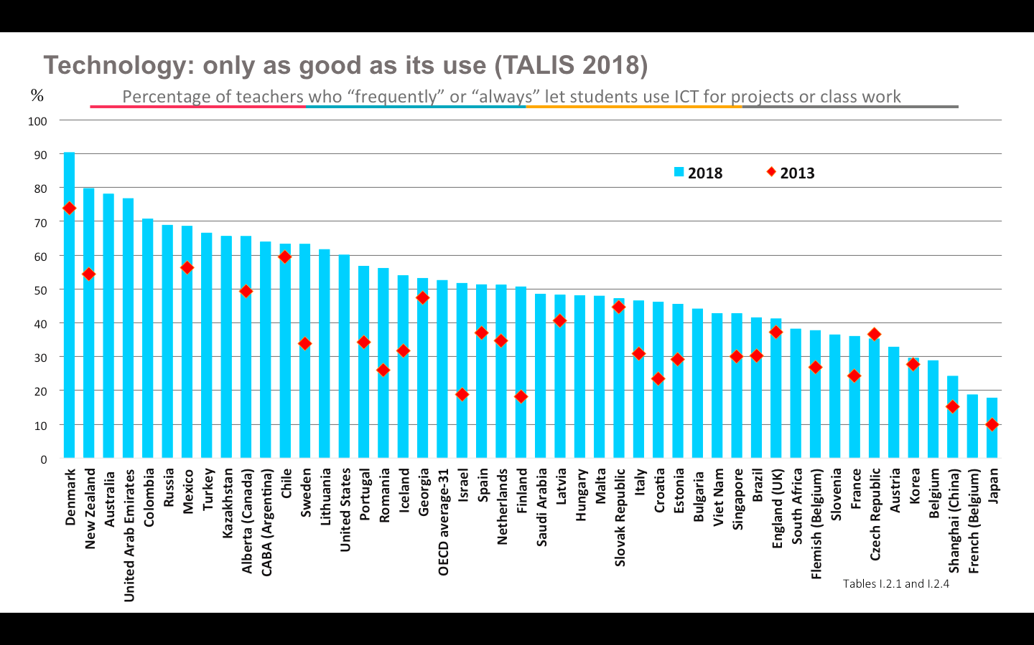

Slide 23
Prosperity
Enhancing Technology

Slide 24
The Primacy of Physical Schools & Teaching
Enhancing Good Teaching
Universal Public Access
Unique Value Proposition
Disciplined Innovation
Risk Reduction
Inclusive Design
Teacher Professionalism
9. Public Responsibility
10. Social Benefit

Slide 25
Ontario (2014)
Broad Excellence
Equity
Wellbeing
Public Confidence

Slide 26
Leading FROM the Middle
≠
Leading IN the Middle

Slide 27
Leading in the Middle
Level, Layer, or Tier
Improving Performance
Better Systems
Coherence & Connection
Implementing Initiatives

Slide 28
Leading in the Middle | Leading from the Middle
Level, Layer, or Tier | Center, Core & Heart
Improving Performance | Transforming Learning & Well-Being
Better Systems | Stronger Communities
Coherence & Connection | Collective Responsibility
Implementing Initiatives | Taking Initiative

Slide 29
Leading from the Middle
Scotland
Wales
Northwest RISE (US)
Nova Scotia (Canada)
Czech Republic

Slide 30
Three Components of Leading from the Middle
A philosophy
A structure
3. A culture

Slide 31
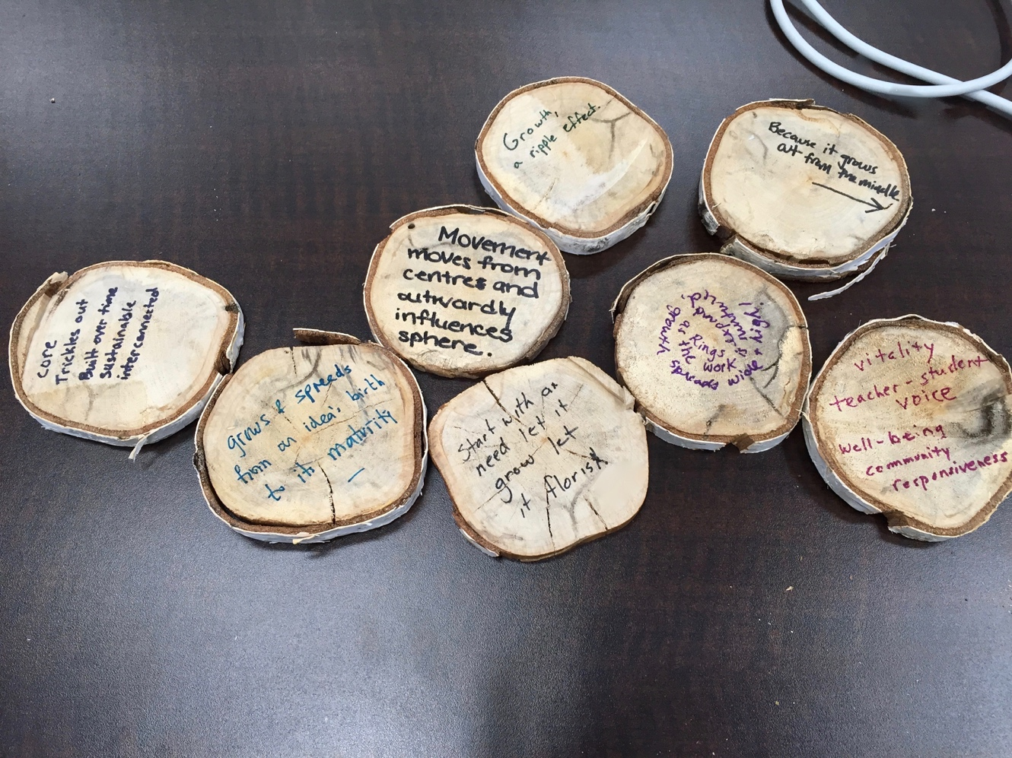
A Philosophy of Practice

Slide 32
The essence of Leading from the Middle is making real your vision. It’s about moving those ideas into concrete practice and making a positive difference, for all your students and for all your staff so that everybody just loves their learning environment .
I don’t see it as connected to personnel. I see the whole notion is a concept or a philosophy or a principle of wanting to get as close to the action as you possibly can.
A Philosophy of Practice

Slide 33
Interdisciplinary Teams
We have an IDT model that we use when schools are stuck with a particular situation, scenario, or student issue. It’s an inter-disciplinary team. They bring all of the team together, so classroom teachers, psychologist, social worker, family, outside agency and partnerships come to that table and every voice is equally valued.
A Structure of Interdisciplinary Teams

Slide 34
A Structure of Interdisciplinary Teams

Slide 35
One of the things that really worked is to ask the teachers to bring a picture of their student. They actually had the fact of their student of wonder right there in front of them. In the middle.
Attention is given to things like “their language spoken, when are they most joyful, when are they most engaged. We really wanted to address the whole child, not just their learning needs.”
A Structure of Interdisciplinary Teams

Slide 36
Thank you

